Slide 1

Smart Home Automation using IOT
By: Vandan Pandya (18mca167)
Keyur Choksi (18mca155)
Guide : Prof. Sonia Mittal

Slide 2

What makes a home “Smart Home”?

Slide 3
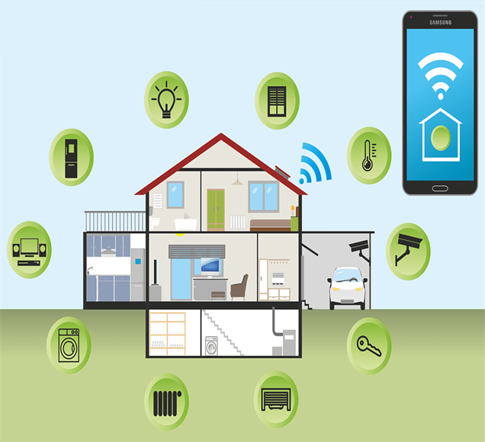
Home Automation
A smart some automation system typically controls following things:
Lighting Control
Entertainment Systems
Climate of the room
Appliances
It also includes security such as:
Access Control
Alarm System
When all these devices are connected to internet it makes Internet of Things (IoT).

Slide 4

How it works?
A home automation system connects all the controlled devices to a central Hub or Gateway.
The user interface for control of the system can be used by followings:
Wall-mounted terminals, tablet or desktop computers
Mobile phone application
Web interface, that may also be accessible off-site through the Internet.

Slide 5

Implementation of Lighting System using Motion detection

Slide 6



Requirements for the System
Microcontroller:
Microcontrollers are tiny computers which contains one or more computer processors, memory and programmable input/output peripherals all in a single integrated circuit.
It can be thought of as a development boards which are printed circuit boards containing MCU (Memory Control Unit) and the supporting components needed to program the MCU.
There are many microcontrollers available:
Arduino UNO
Raspberry Pi
NodeMCU

Slide 7
Choosing best Microcontroller for Lightning System
Comparative Study
Technical Specification | NodeMCU (ESP-8266) | Arduino Uno | Raspberry Pi Model B+
Operative Voltage | 3.3V | 5V | 5V
Processor | Tensilica L 106 | ATMega328P | Quad-core ARM Cortex A53
Clock Speed | 26 Mhz-52 MHz | 16 MHz | 1.2 GHz
Flash Memory | up to 4MB | 32 KB | -
System Memory | 128 KB | 2 KB | 1 GB
Development Environment | Arduino IDE | Arduino IDE | any Linux Compatible IDE
Operating System | XTOS | - | Raspbian
Communication Supported | IEEE 802.11 b/g/n | IEEE 802.11 b/g/n IEEE 802.15.4 433RF BLE 4.0 via Shield | IEEE 802.11 b/g/n IEEE 802.15.4 433RF BLE 4.0Ethernet Serial
Price (Rs.) | 290-340 | 300 - 350 | 2600 - 3000

Slide 8
How NodeMCU is compatible for the system..
NodeMCU is having inbuilt WIFI, you can connect NodeMCU to internet without much effort compare to connecting UNO to internet.
The best thing is NodeMCU is Arduino compatible you can do all possible stuff that can be done with UNO. We can also program NodeMCU in 'C' language using Arduino IDE directly.
Hardware comparison
NodeMCU comes with 128KB RAM and UNO it’s just 2kB RAM so NodeMCU is having more ram space.
NodeMCU is having 4MBytes of ROM (flash) and UNO is just 32 KB, NodeMCU can store more code compare to UNO.
NodeMCU comes with micro USB port and UNO is comes with USB type B connector, micro USB cable is easy available compare to USB type B.
NodeMCU development board is smaller in size compared to Arduino UNO.
NodeMCU and UNO priced almost same, so you can opt to buy NodeMCU.

Slide 9
Components Used
NodeMCU
Bread Board
PIR Sensor
LDR Sensor
Power Supply Module
Relay Module
Jumper Wires

Slide 10
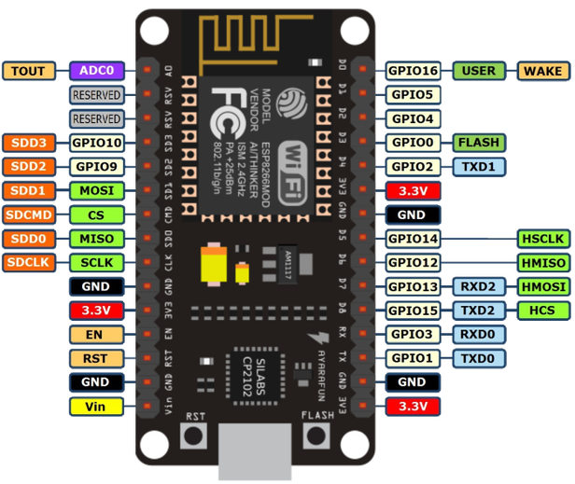
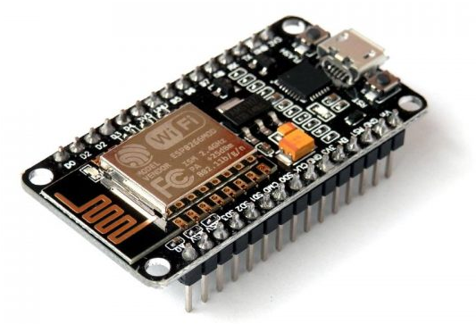
NodeMCU
ESP8266 is a low-cost, Open source WiFi Module chip produced by “Espressif Systems” that can be configured to connect to the Internet for Internet of Things(IoT).
It can be programmed directly through USB port using LUA programming or Arduino IDE.
By simple programming we can establish a WiFi connection and define input/output pins according to your needs exactly like arduino, turning into a web server and a lot more.
NODEMCU can be programmed using Arduino IDE.

Slide 11
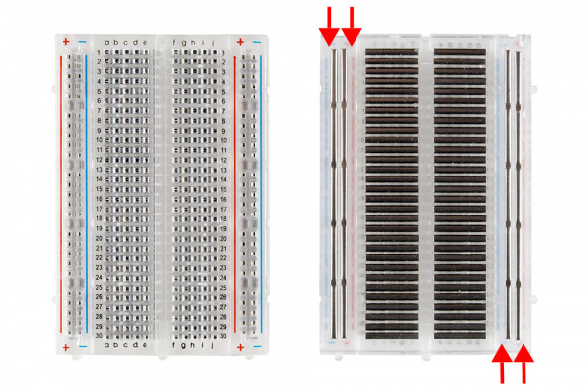
Breadboard
A breadboard is a solder less device for temporary prototype with electronics and test circuit designs.
These are great units for making temporary circuits and prototyping, and they require absolutely no soldering.
Most electronic components in electronic circuits can be interconnected by inserting their leads or terminals into the holes and then making connections through wires where appropriate.
The breadboard has strips of metal underneath the board and connect the holes on the top of the board.

Slide 12
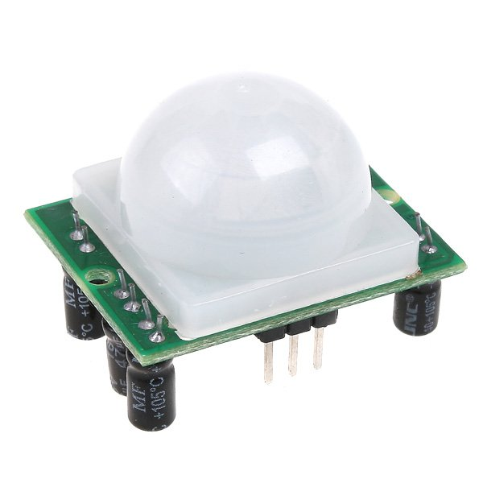
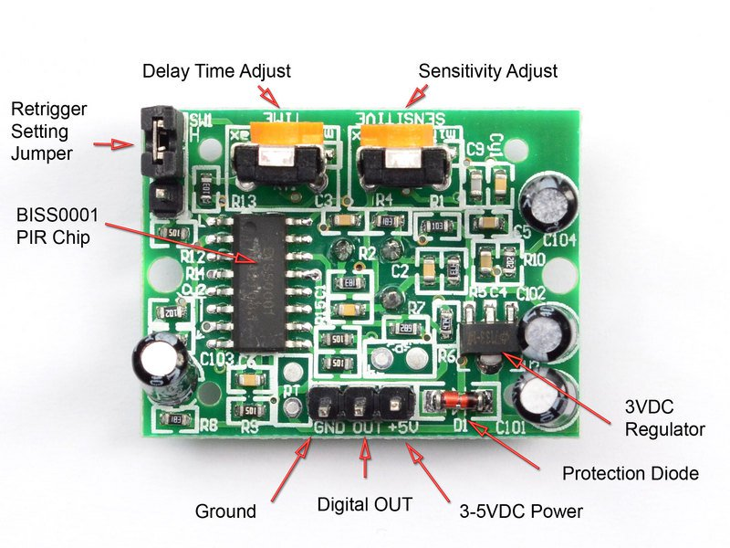
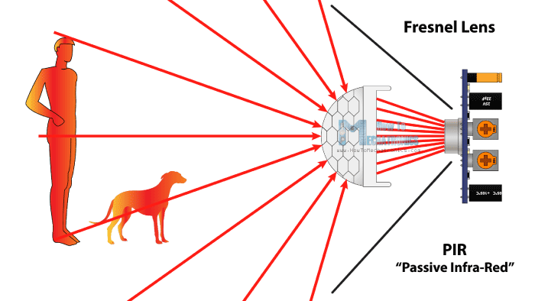
PIR Sensor
A passive infrared sensor (PIR sensor) is an electronic sensor that measures infrared (IR) light radiating from objects in its field of view. They are most often used in PIR-based motion detectors.
A PIR-based motion detector is used to sense movement of people, animals, or other objects. They are commonly used in burglar alarms and automatically activated lighting systems.

Slide 13
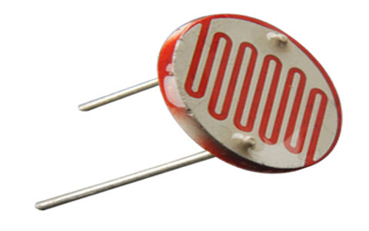
LDR Sensor
It is a one type of resistor whose resistance varies depending on the amount of light falling on its surface.
LDR refers to Light dependent resistor.
When the light falls on the resistor, then the resistance changes.
These resistors are often used in many circuits where it is required to sense the presence of light.
These resistors have a variety of functions and resistance. For instance, when the LDR is in darkness, then it can be used to turn ON a light or to turn OFF a light when it is in the light.
A typical light dependent resistor has a resistance in the darkness of 1MOhm, and in the brightness a resistance of a couple of KOhm

Slide 14
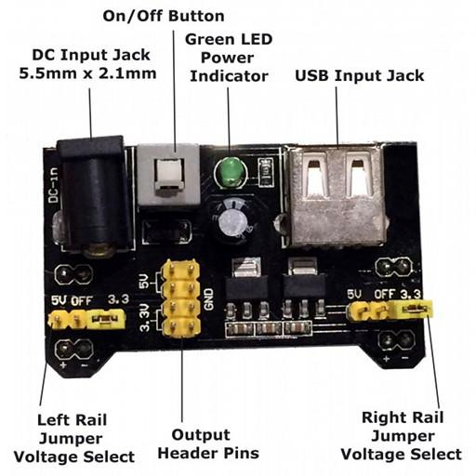
Power supply module
This is a 3.3V/5V MB102 Breadboard Power Supply Module which provides a dual 5 V and 3.3 V power rails and has a multi-purpose female USB socket.
Power supply modules are used to convert AC power into usable DC power so that the system to be powered may operate properly.
They provide electrical protection in the form of fuses or breakers.
It is also there for safety reasons so that power grid high voltages are not (usually) present inside an electronic system.

Slide 15
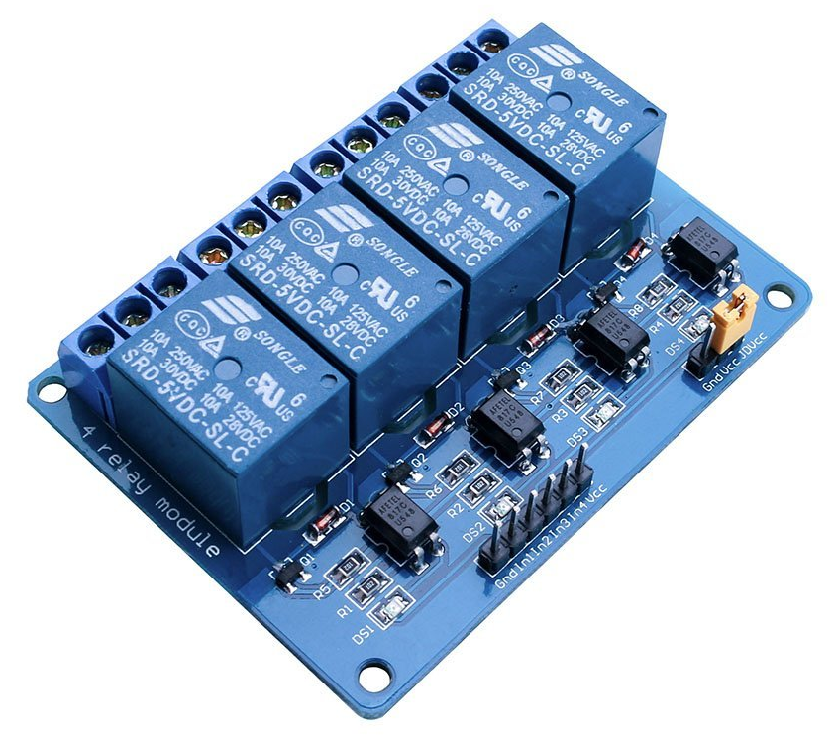
Relay Module
A relay is an electrically operated switch that can be turned on or off, letting the current go through or not, and can be controlled with low voltages, like the 5 V provided by the Arduino pins.
This relay module has four channels (those blue cubes). There are other models with one, two and eight channels.
This module should be powered with 5V, which is appropriate to use with an ESP8266. There are other relay modules that are powered using 3.3V, which is ideal for ESP32, Arduino, and other microcontrollers.

Slide 16
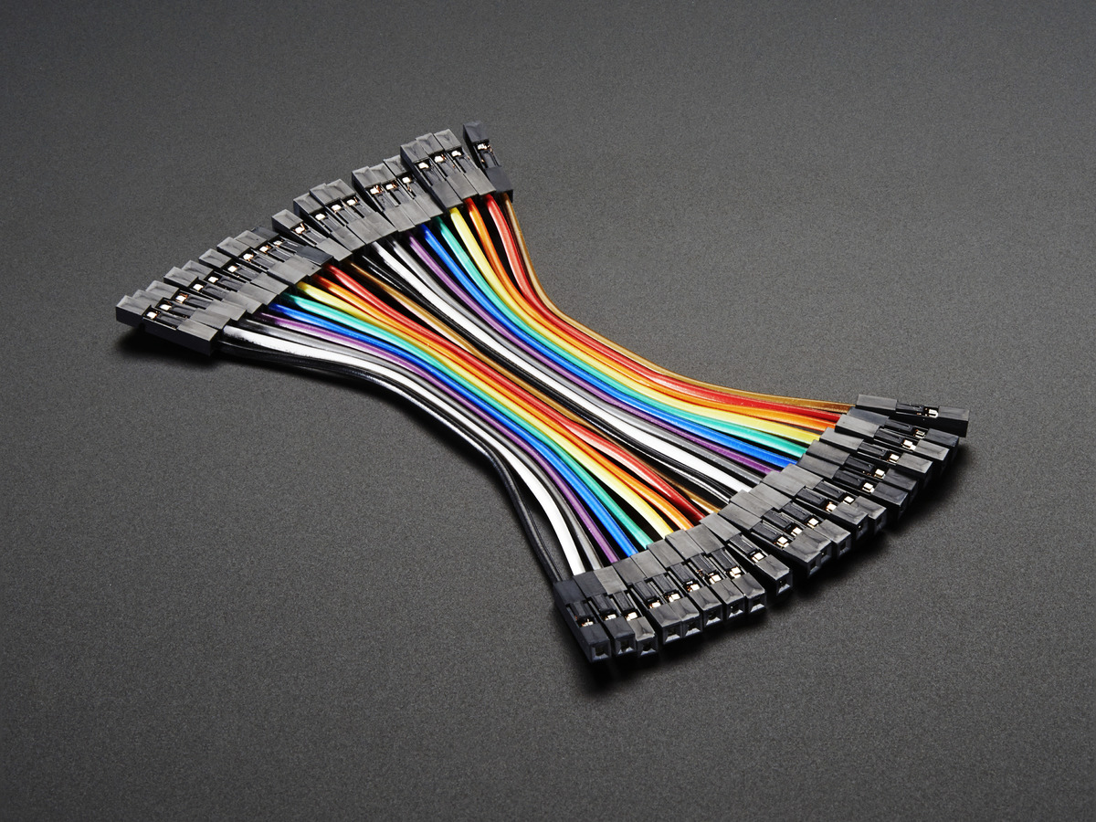
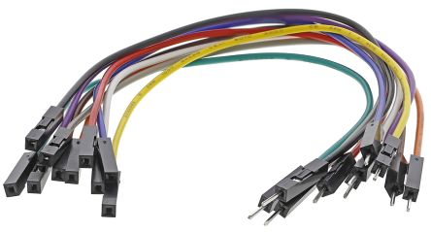
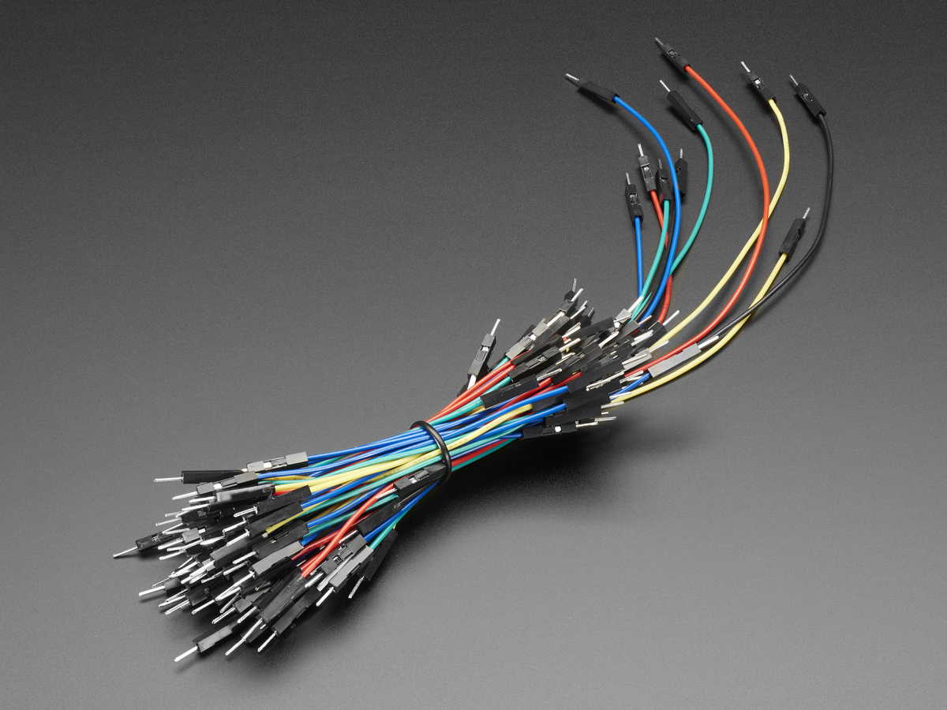
Jumper wires
A jumper wire is an electrical wire, or group of them in a cable, with a connector or pin at each end, which is normally used to interconnect the components of a breadboard or other prototype or test circuit, internally or with other equipment or components, without soldering.
Individual jump wires are fitted by inserting their "end connectors" into the slots provided in a breadboard, the header connector of a circuit board, or a piece of test equipment.
Female to Female Wires
Female to Male Wires
Male to Male Wires

Slide 17
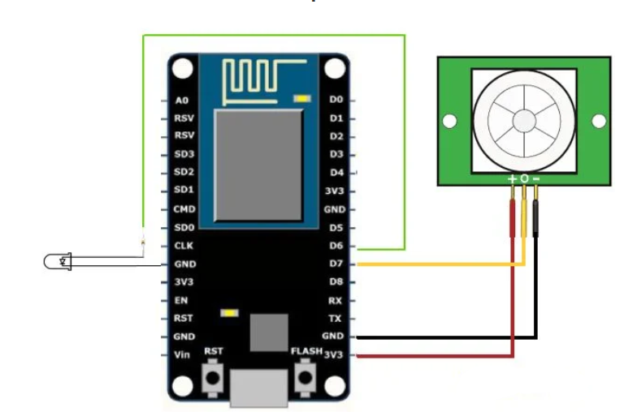
Circuit Diagram of PIR Sensor

Slide 18
Code of Arduino IDE for PIR Demo
int ledpin = 12;
int sensor = 13;
void setup() {
Serial.begin(115200);
pinMode(sensor, INPUT); //Declare sensor as input
pinMode(ledpin, OUTPUT); //Declare LED as output
}
void loop() {
int state = digitalRead(sensor); // Here PIR sensor sense and stores in state
Serial.println(state);
if(state == HIGH)
{
digitalWrite(ledpin, HIGH);
Serial.println("Motion detected!!");
delay(5000);
}
else
{
digitalWrite(ledpin, LOW);
Serial.println("Motion absent!!");
delay(100);
}
}

Slide 19
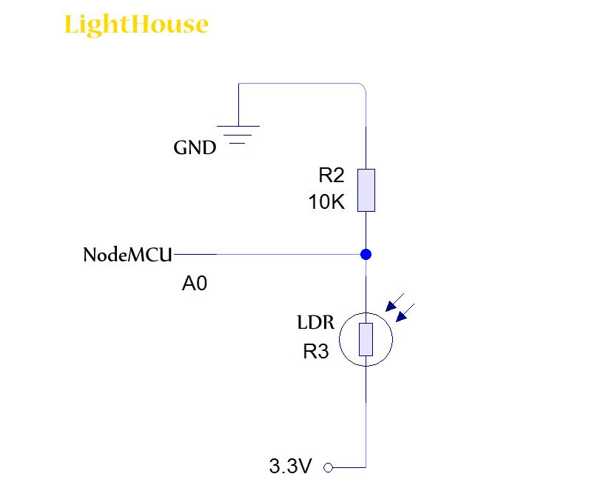
Circuit Diagram of LDR Sensor

Slide 20
Code of Arduino IDE for LDR Demo
int ledpin = 12;
int ldrPin = A0;
void setup() {
Serial.begin(115200);
pinMode(ledpin, OUTPUT); //Declare LED as output
pinMode(ldrPin, INPUT); //Declare ldr sensor as input
}
void loop() {
int state = digitalRead(sensor); // Here PIR sensor sense and stores in state
Serial.println(state);
if(ldrstatus <= 300 ) {
digitalWrite(ledpin, HIGH);
delay(5000);
}
else {
digitalWrite(ledpin, LOW);
delay(100);
}
}

Slide 21
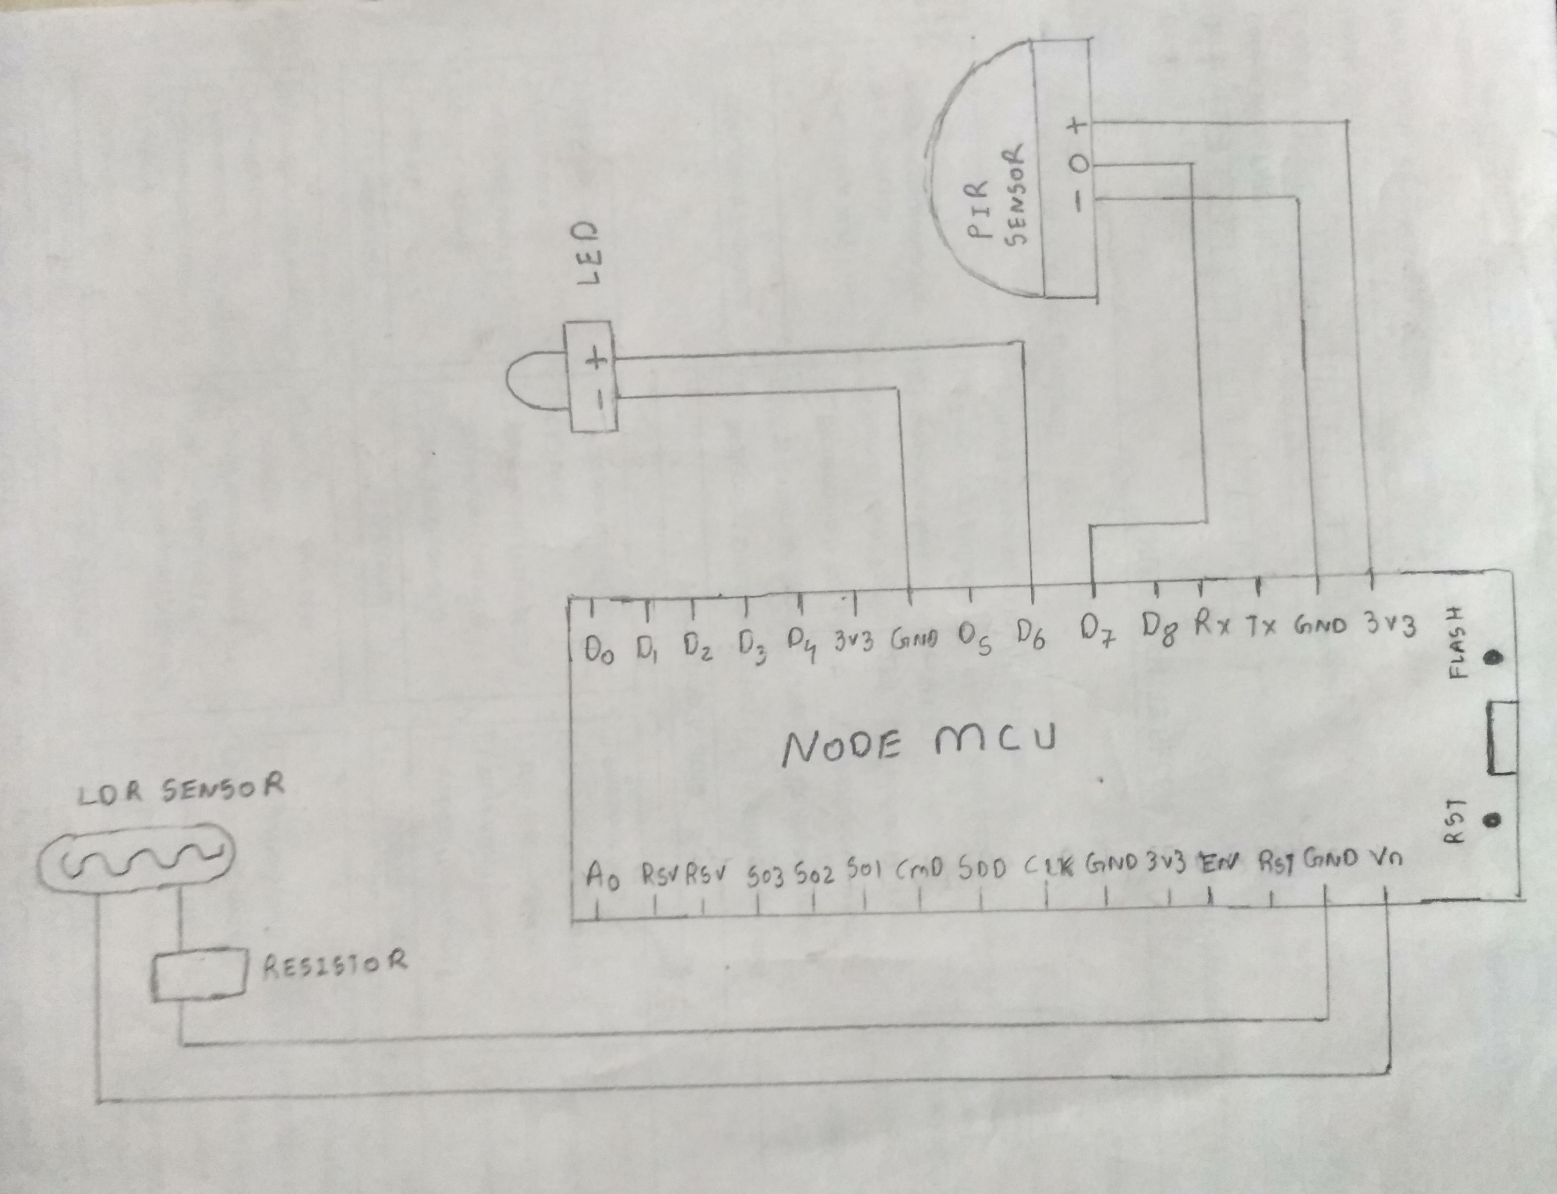
Circuit Diagram for LDR + PIR Demo

Slide 22
Code of Arduino IDE for LDR + PIR Demo
int ledpin = 12;
int sensor = 13;
int ldrPin = A0;
void setup() {
Serial.begin(115200);
pinMode(sensor, INPUT); //Declare sensor as input
pinMode(ledpin, OUTPUT); //Declare LED as output
pinMode(ldrPin, INPUT); //Declare ldr sensor as input
}
void loop() {
int state = digitalRead(sensor); // Here PIR sensor sense and stores in state
int ldrstatus = analogRead(ldrPin); // Here LDR sensor sense and stores in ldrstatus
Serial.println(state);
if(state == HIGH && ldrstatus <= 300 ) {
digitalWrite(ledpin, HIGH);
Serial.println("Motion detected..!! & Lights On..!!");
delay(5000);
}
else {
digitalWrite(ledpin, LOW);
Serial.println("Motion absent..!! & Lights Off..!!");
delay(100);
}
}

Slide 23
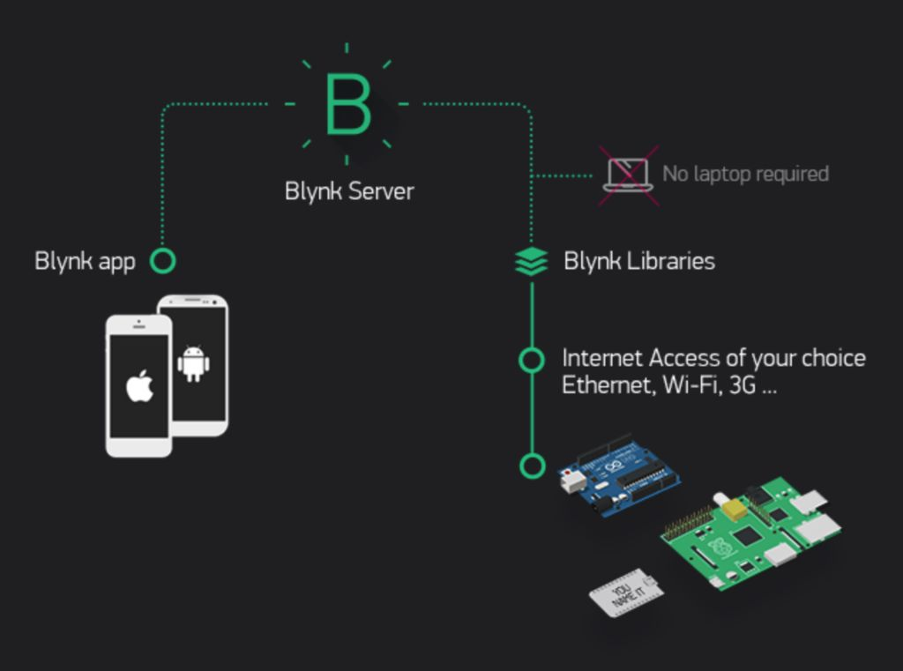
What is Blynk & How it Works?
The most popular IoT platform to connect your devices to the cloud, design apps to control them, and manage deployed products at scale.

Slide 24
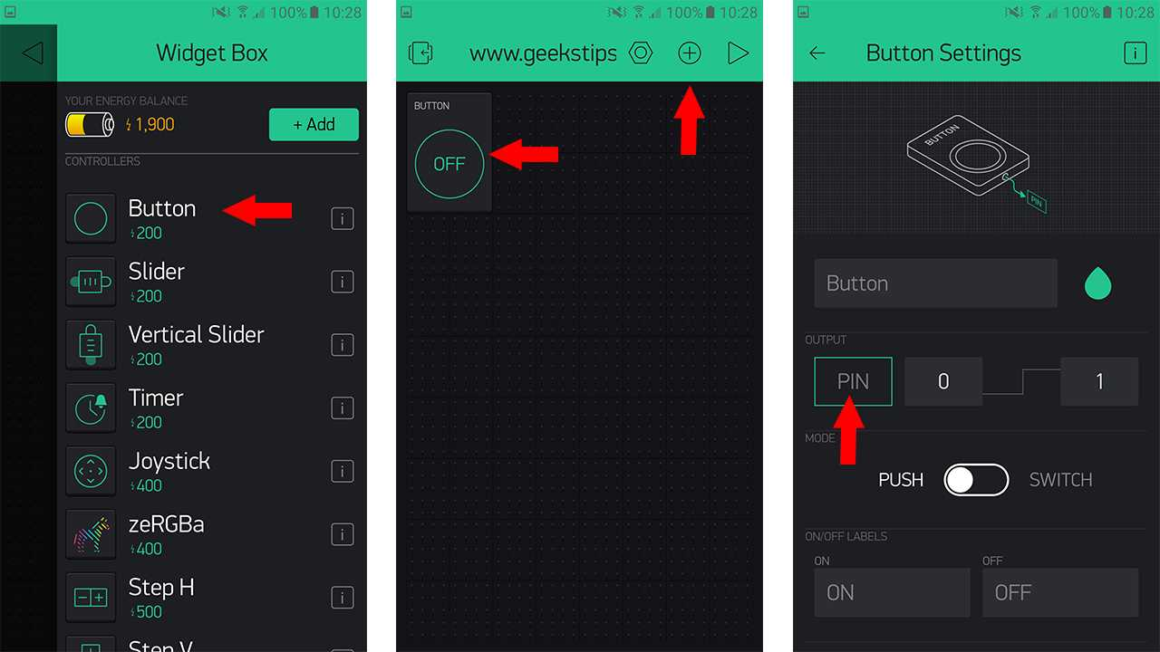
What is Blynk & How it Works?
You can create a project dashboard and arrange buttons, sliders, graphs, and other widgets onto the screen in Official Blynk App.

Slide 25
Code of Arduino IDE for Blynk
#define BLYNK_PRINT Serial
#include <ESP8266WiFi.h>
#include <BlynkSimpleEsp8266.h>
// You should get Auth Token in the Blynk App.
// Go to the Project Settings (nut icon).
char auth[] = "0e66315e07a7443ab01a98071c329741";
// Your WiFi credentials.
// Set password to "" for open networks.
char ssid[] = "Vandan's iPhone";
char pass[] = "vandan2223";
void setup()
{
// Debug console
Serial.begin(9600);
Blynk.begin(auth, ssid, pass);
}
void loop()
{
Blynk.run();
}

Slide 26
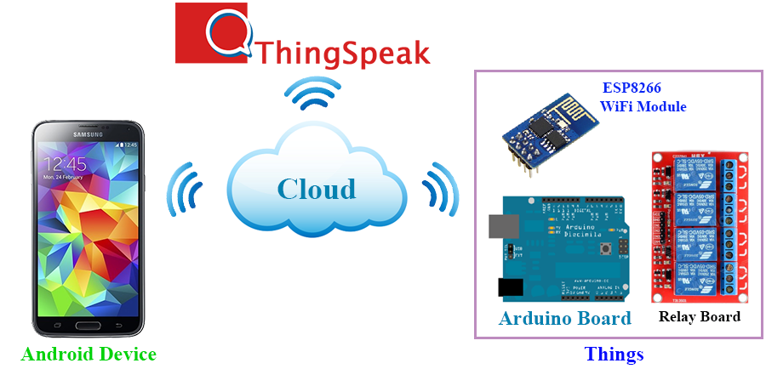
What is ThingSpeak Cloud & How it Works?
ThingSpeak™ is an open-source Internet of Things (IoT) application and API to store and retrieve data from things using the HTTP protocol over the Internet or via a Local Area Network.
It is an IoT analytics platform service that allows you to aggregate, visualize and analyse live data streams in the cloud.

Slide 27
Code of Arduino IDE for ThingSpeak Cloud
#include <ESP8266WiFi.h>
#include <ESP8266HTTPClient.h>
WiFiClient client;
String thingSpeakAddress = "http://api.thingspeak.com/update?";
String writeAPIKey;
String tsfield1Name;
String request_string;
HTTPClient http;
int ledpin = 12,sensor = 13,ldrPin = A0;
void setup() {
Serial.begin(115200);
pinMode(sensor, INPUT); //Declare sensor as input
pinMode(ledpin, OUTPUT); //Declare LED as output
pinMode(ldrPin, INPUT); //Declare ldr sensor as input
WiFi.disconnect();
WiFi.begin("hey", "9924223308");
while ((!(WiFi.status() == WL_CONNECTED)))
{
Serial.println("Not Connected");
delay(300);
}
Serial.println("Connect");
}

Slide 28
Code of Arduino IDE for ThingSpeak Cloud (Cont..)
void loop() {
int state = digitalRead(sensor); // Here PIR sensor sense and stores in state
int ldrstatus = analogRead(ldrPin); // Here LDR sensor sense and stores in ldrstatus
Serial.println(state);
Serial.println(ldrstatus);
if(state == 1 && ldrstatus <= 300)
{
if (client.connect("api.thingspeak.com",80)) {
request_string = thingSpeakAddress;
request_string += "api_key=";
request_string += "Y0S53GNSB81WS2J9";
request_string += "&";
request_string += "field1";
request_string += "=";
request_string += state;
http.begin(request_string);
http.GET();
http.end();
}
digitalWrite(ledpin, 1);
Serial.println("Motion detected!! & Lights On..!!");
delay(5000);
}

Slide 29
Code of Arduino IDE for ThingSpeak Cloud (Cont..)
else
{
if (client.connect("api.thingspeak.com",80)) {
request_string = thingSpeakAddress;
request_string += "api_key=";
request_string += "Y0S53GNSB81WS2J9";
request_string += "&";
request_string += "field1";
request_string += "=";
request_string += state;
http.begin(request_string);
http.GET();
http.end();
}
digitalWrite(ledpin, 0);
Serial.println("Motion absent!! & Lights Off..!!");
delay(100);
}
}

Slide 30
Thank You!

